Slide 1
Machine Learning I
Day 8
Fundamental concepts and supervised techniques
Dr Ayham Zaitouny and Dr Leonardo Portes dos Santos
Research Fellows
Department of Mathematical and Statistical sciences, UWA
ayham.zaitouny@uwa.edu.au
Leonardo.portesdossantos@uwa.edu.au

Slide 2

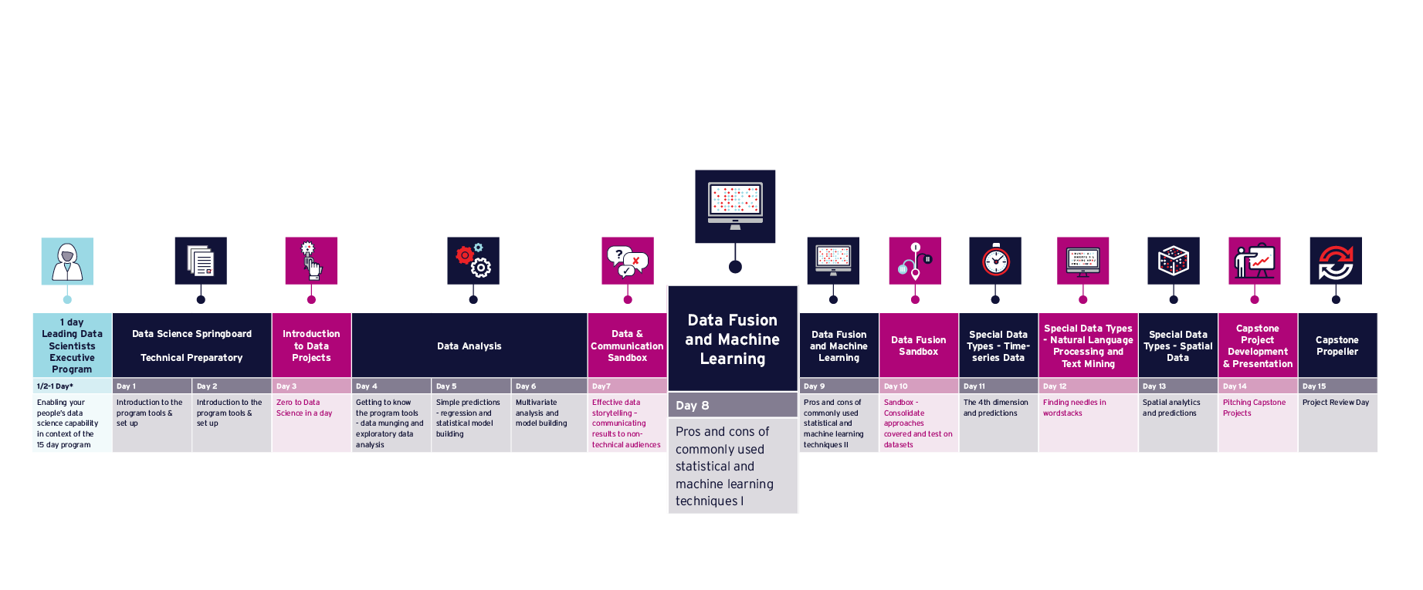
Program Timeline

Slide 3
Plan of the day
AWST | AEST | Agenda | Educator
07:30 | 09:30 | Q&A, Issues & Announcements
07:45 | 09:45 | The Machine Learning Landscape | Ayham
09:15 | 11:15 | Morning tea
09:30 | 11:30 | Supervised techniques | Leonardo
11:00 | 13:00 | Lunch
11:45 | 13:45 | Capstone Project Update/Share | Tamryn/All
12:15 | 14:15 | Evaluating the ML model | Ayham
13:15 | 15:15 | Afternoon tea
13:30 | 15:30 | More about ML | Leonardo
14:45 | 16:45 | Closeout – Reflections, Takeaways
14:55 | 16:55 | Menti Feedback | Tamryn
15:00 | 17:00 | Close

Slide 4
8
Introduce fundamental concepts of supervised ML and what are the crucial steps in an end-to-end machine learning strategy from data.
Explore traditional supervised classification techniques and the evaluation metrics for error analysis.
Introduce open-source toolboxes and packages that can be applied to mining/energy data.
Understand the key steps to develop a machine learning investigation from data.
Understand how to evaluate, validate and prevent problems such as overfitting and underfitting.
Understand which techniques are best suited for a ML problem and how to design the learning model.
Understand the advantages and disadvantages for the techniques to select the correct type of model given available data.

Slide 5
Getting the Anaconda environment prepared
Go to GitHub /08-machinelearning and create the environment use: environment.yml
If you don’t have Anaconda: download it at https://www.anaconda.com/distribution/
Mac:
Open command prompt/terminal and type:
conda env create -f environment.yml
conda activate week08
Win:
Open command prompt/terminal and type:
conda env create -f environment.yml
activate week08
Or use Anaconda Interface (GUI)
Ayham and Leonardo (UWA)

Slide 6
Day 8 The Machine Learning Landscape

Slide 7
Day 8 What is Machine Learning?
Ayham and Leonardo (UWA)

Slide 8


Day 8 What is Machine Learning?
Arthur Samuel (1959) addressed the Machine Learning as a field of study that gives computers the ability to learn without being explicitly programmed.
Machine learning is the science (art) of programming computers so they can learn from data. Data or examples that the system is using to learn are called “training set”, each training example is called “training instance or sample”. (Aurelien Geron)
A computer program is said to learn from experience E with respect to some task T and some performance measure P, if its performance on T, as measured by P, improves with experience E. (Tom Mitchell)
Learn from experience
Learn from data
Ayham and Leonardo (UWA)

Slide 9
Day 8 Artificial Intelligence vs Machine Learning vs Data Mining
Ayham and Leonardo (UWA)

Slide 10
Day 8 Artificial Intelligence vs Machine Learning vs Data Mining
DM: applying techniques to dig into large amounts of data to discover patterns that were not immediately apparent.
ML: goes beyond DM and provides the system the ability to build a trained model that can predict and compare new data or situations based on the training set.
AI
ML
DM
AI: goes beyond ML and provides the system the ability to take decisions so the model can create associations among events and situations without ever having seen such patterns or data before.
Ayham and Leonardo (UWA)

Slide 11
Day 8 Why is Machine Learning great?
Ayham and Leonardo (UWA)

Slide 12
Day 8 Why is Machine Learning great?
Traditional approaches are based on writing rules while ML is based on training from examples and data.
Explicit rules and instructions are replaced by finding patterns in the data.
ML algorithms can find solutions for problems that either are too complex for traditional approaches.
Learn and adapt to changes and new data.
ML can help humans learn to get insights about complex problems and large amounts of data as they can be inspected to see what they have learned.
“If a typical person can do a mental task with less than one second of thought,
we can probably automate it using AI either now or in the near future.” — Andrew Ng
Ayham and Leonardo (UWA)

Slide 13
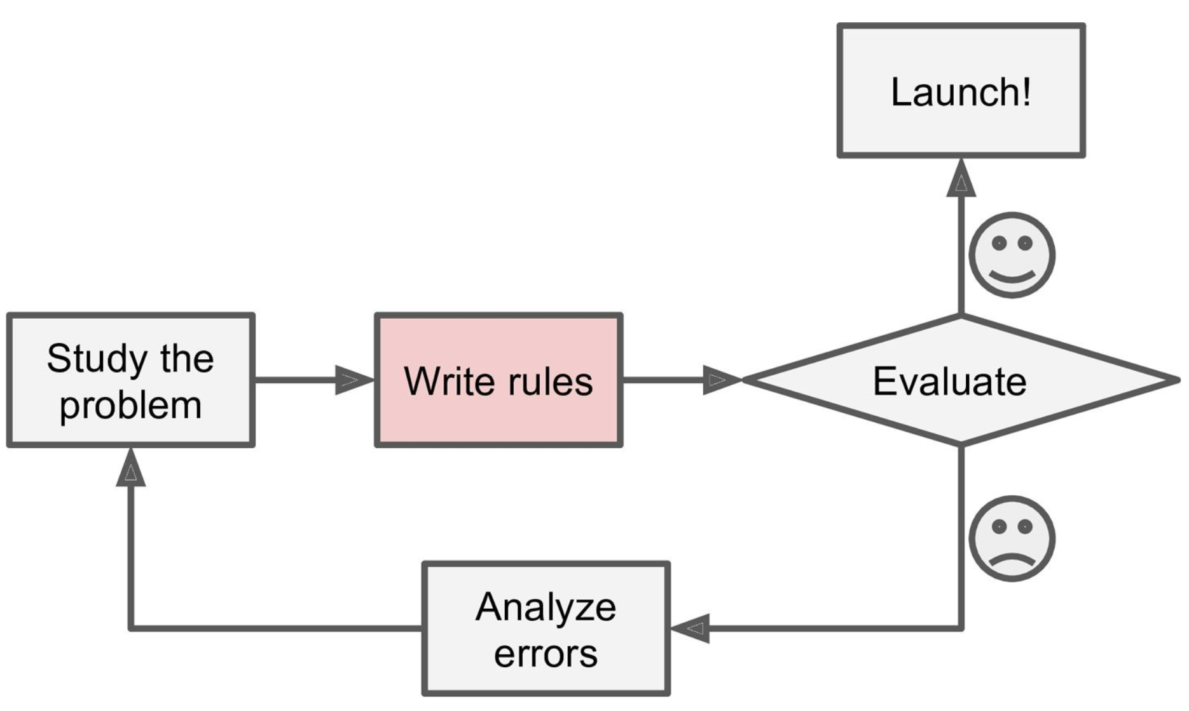
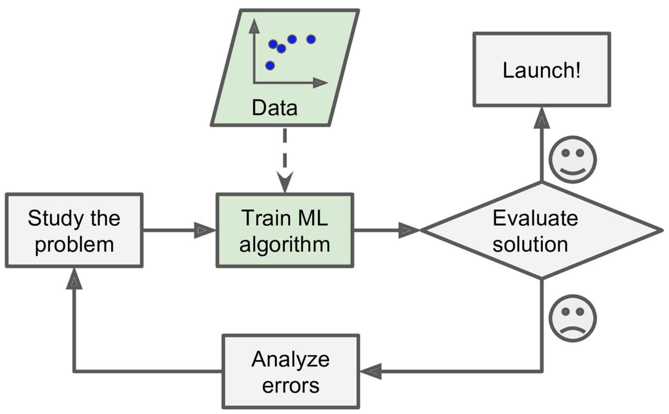
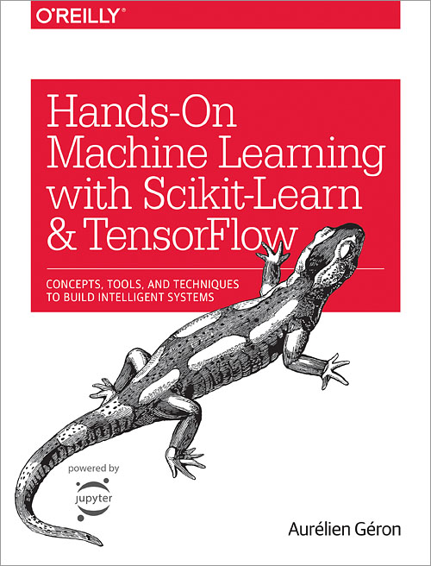
Day 8 WorkFlow of a Typical ML Project
Traditional approach
ML approach
Source:
Ayham and Leonardo (UWA)

Slide 14
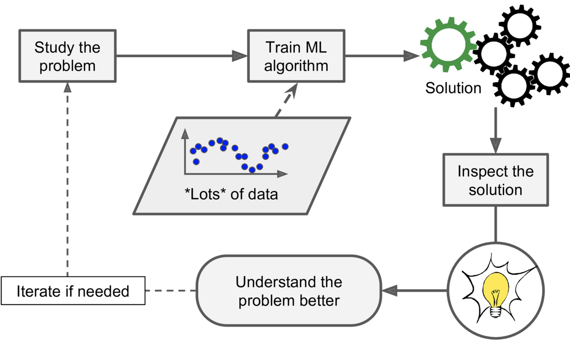
Day 8 WorkFlow of a Typical ML Project
Source:
Ayham and Leonardo (UWA)

Slide 15
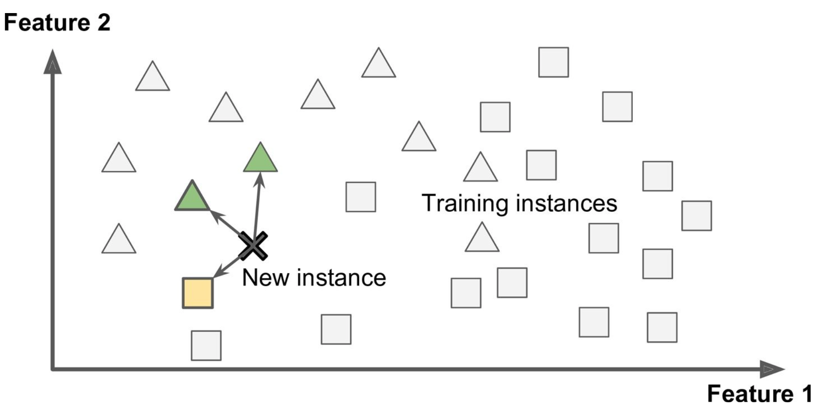
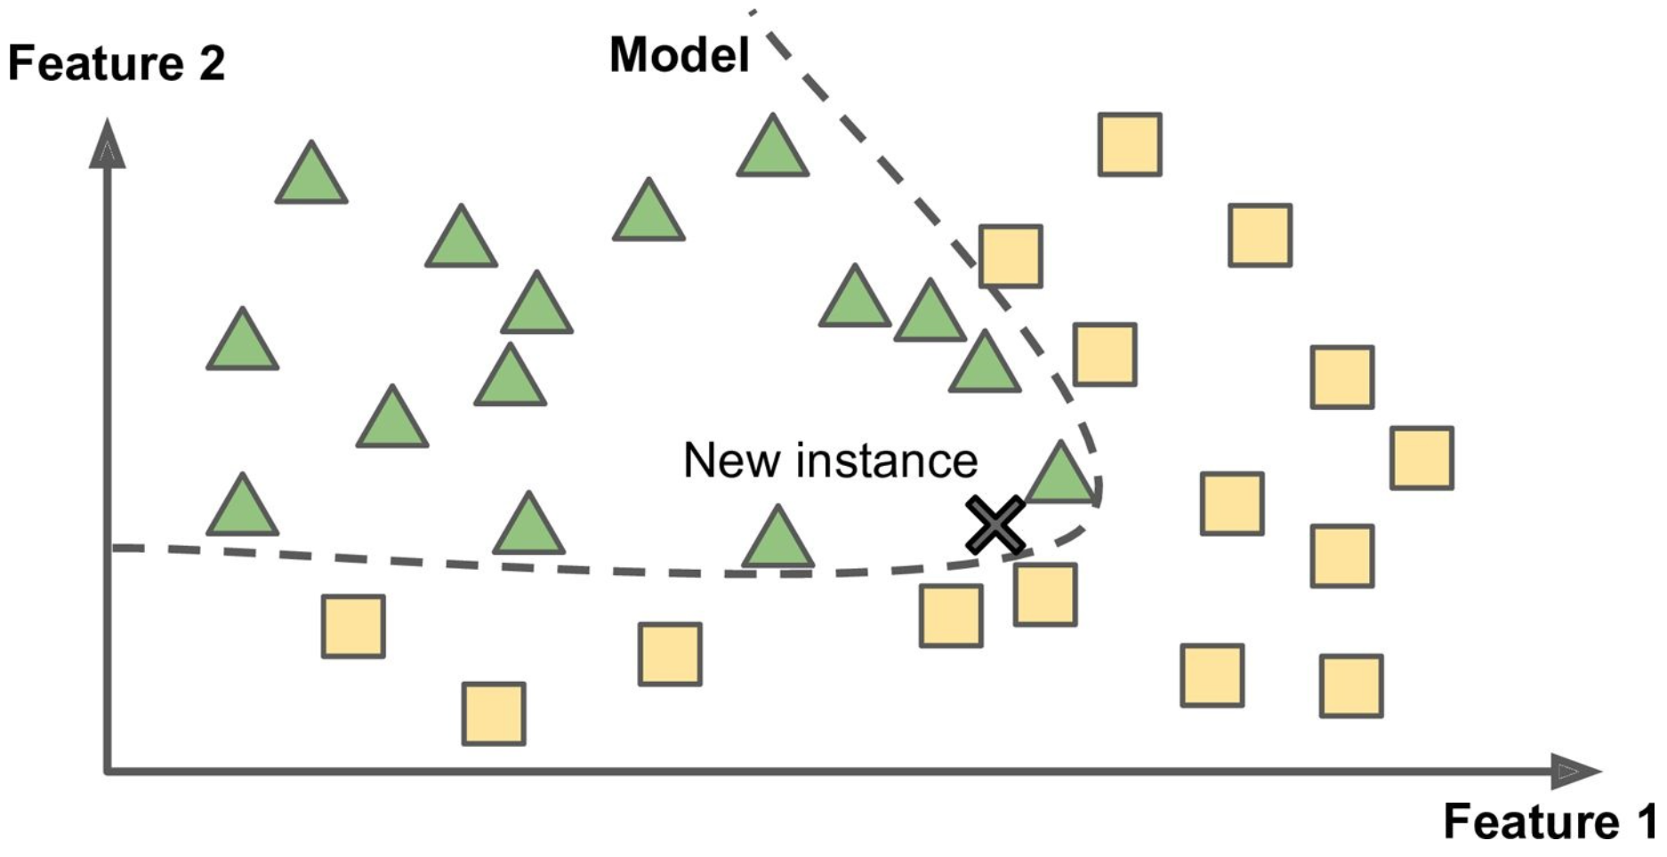
Day 8 Some types of ML models
Whether they work by simply comparing new data points to known data points, or instead detect patterns in the training data and build a prediction model:
Instance-based learning: The new instances must be identical to the training instances or very similar (requires similarity measure). K-nearest neighbour algorithm
Model-based learning: Using a model of examples to generalise the prediction of new instances. Support Vector Machine
Ayham and Leonardo (UWA)
Source: Hands on machine learning with Scikit-learn and TensorFlow

Slide 16
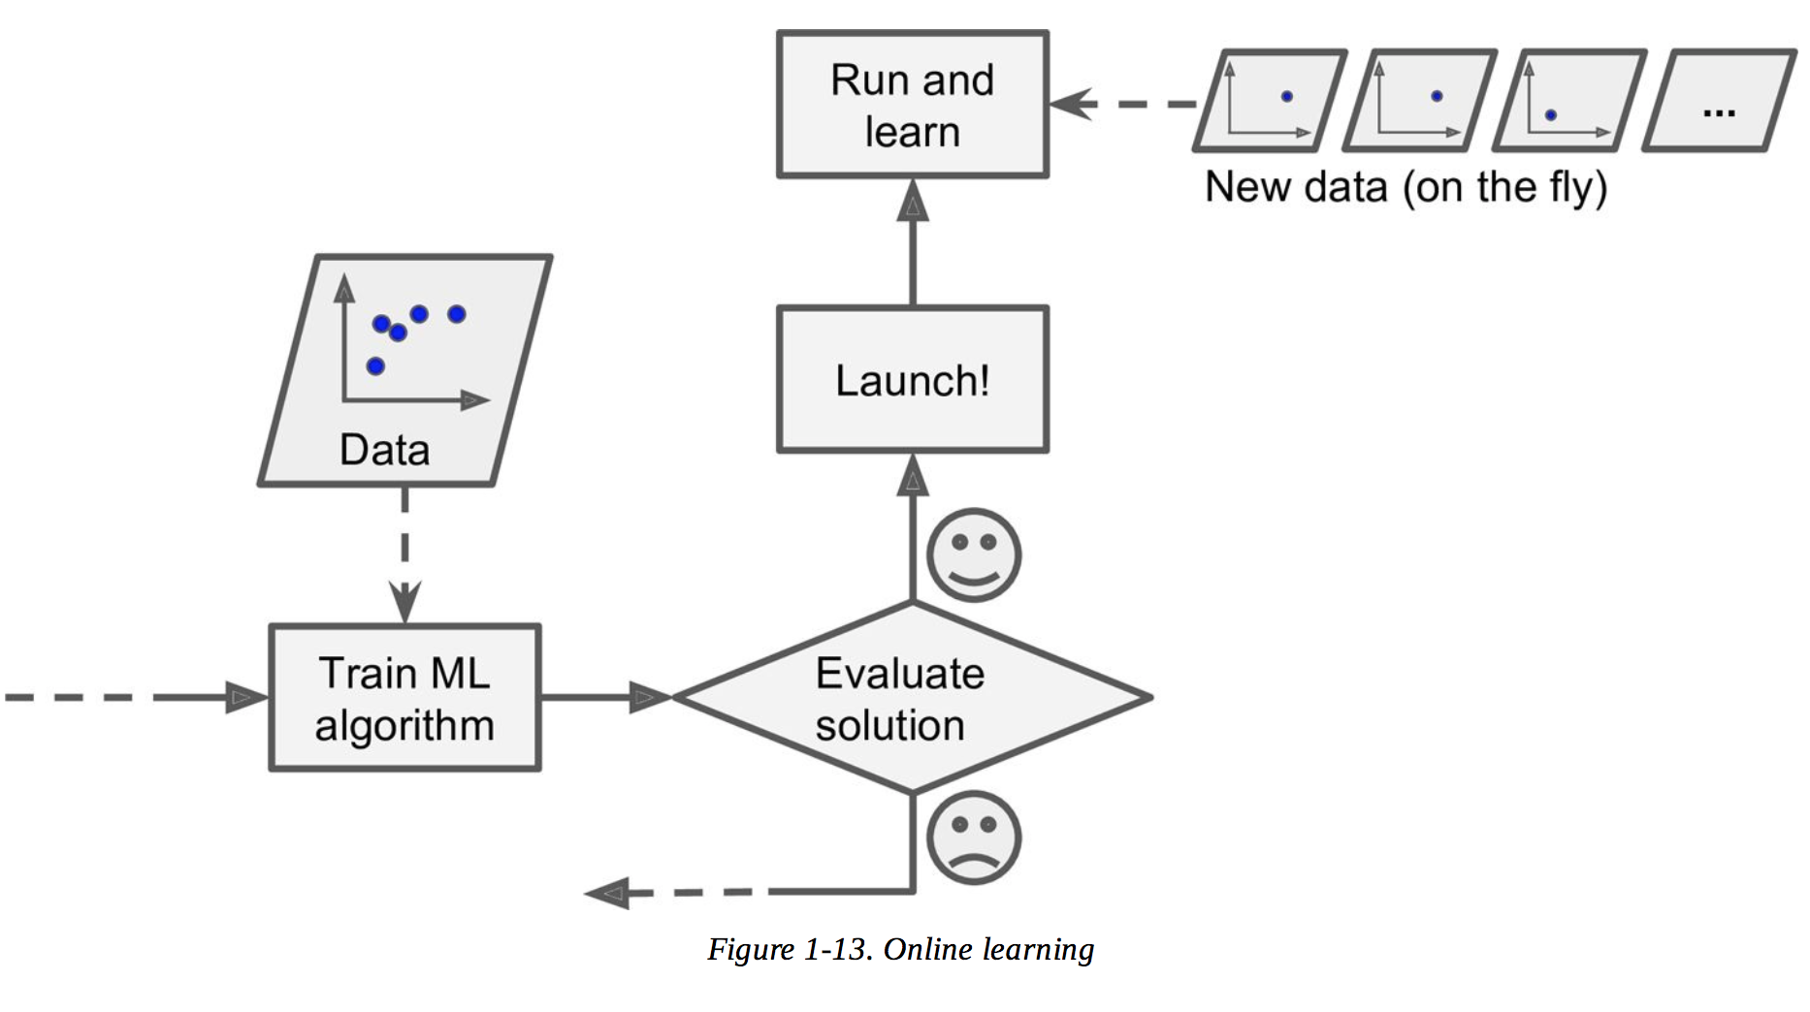
Day 8 Some types of ML models
Whether or not they can learn incrementally from a stream of incoming data:
Batch learning (offline learning): Time consuming and requires a lot of computing resources.
Online learning: Feed new data instances sequentially, fast and cheap. A big challenge is that if bad data fed to the system, the performance gradually declines.
Ayham and Leonardo (UWA)
Source: Hands on machine learning with Scikit-learn and TensorFlow

Slide 17
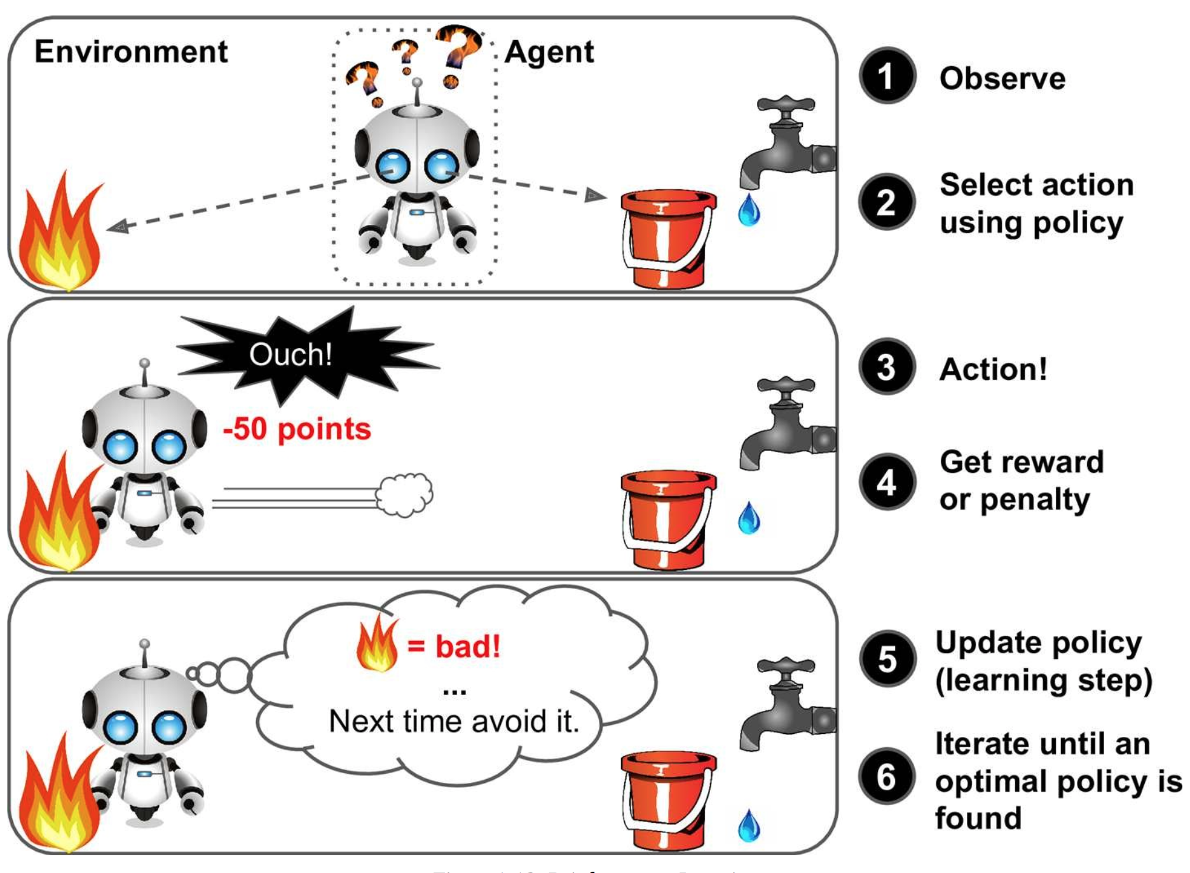
Day 8 Some types of ML models
Whether or not they are trained with human supervision:
Supervised learning
Unsupervised learning
Reinforcement learning: The agent (the learning system) observes the environment to get rewards or penalties in return to learn by itself the best strategy (policy).
Ayham and Leonardo (UWA)
Source: Hands on machine learning with Scikit-learn and TensorFlow

Slide 18
Day 8 Supervised vs Unsupervised Learning
Supervised learning: the training data we feed to the algorithm includes the desired solutions (called labels). Typical supervised tasks:
Classification
Regression
Most important algorithms:
K-Nearest Neighbours (K-NN)
Linear regression
Logistic regression
Support Vector Machines (SVMs)
Decision trees, Random forests, Gradient Boosting Trees
Neural networks
Unsupervised learning: the training data is unlabeled (doesn’t include a desired solution), the system tries to find structure in the data without using labels. Typical unsupervised tasks:
Clustering
Dimensionality reduction
Most important algorithms:
K-means clustering
Expectation Maximization
Gaussian Mixture Models (GMM)
Hierarchical cluster analysis (HCA)
Principle Component Analysis (PCA)
Kernel PCA
Locally linear embedding
https://scikit-learn.org/stable/tutorial/machine_learning_map/index.html
Ayham and Leonardo (UWA)

Slide 19
Day 8 ML in industry: some examples
Examples of classification/regression tasks:
Ayham and Leonardo (UWA)

Slide 20
Day 8 ML in industry: some examples
Examples of classification/regression tasks:
From industry partners in CORE Skills Pilot:
Used linear regression to check for unaccounted for total gas and whether it is correlated to maximum temperature or wind speed.
Used geochemical data to predict domains for ore/material characterisation. Need to look at if variation in classes unbalances predictions (ore oversampled relative to other lithologies?) geochemical data was able to select clusters as we had a lot of data. Trimmed X fields with missing values - 12 fields we retained including from and to downhole intercepts. Some fields correlated with each other.
Iron ore fluctuations of tonnage yield - predict from logging and geochemical data, missing data and log transform %, create ML pipeline to take account of the transformation, reduce the features were important to go from 200 to 20 - and used supervised learning model to reduce variables which were correlated with each other.
Calcination and superfine - learned how to use temperature, 30 days of energy usage, used iron ore example from week 4 - labelled as good/bad operations then applied KNN - very encouraging initial results but not a lot of data in small test - was able to replicate the experts opinion - with rules (kind of a feature extraction).
Ayham and Leonardo (UWA)

Slide 21
Day 8 Some limitations and challenges in ML
Ayham and Leonardo (UWA)

Slide 22
Day 8 Some limitations and challenges in ML
Lack of good data: Most of ML models requires sufficient amount of data for efficient training and better generalisation.
Non-representative or lack of training data (labeled data): it is crucial that the training data be representative of new data. Sampling method can be flawed (sampling bias).
Poor quality data: full of errors, outliers or noise, such data need to be cleaned before use.
Irrelevant features: ML requires a good set of relevant features to make appropriate associations.
Interpretability and complexity. Some models have too many hyper-parameters to tune.
Tendency to use ML is a ”black-box.”
Ayham and Leonardo (UWA)

Slide 23
Day 8 Some limitations and challenges in ML
Statistical fit
Over-fitting the training data: the model performs well in the training data but does not generalise well.
Under-fitting the training data: the model is too simple to learn the underlying structure of the data.
Ayham and Leonardo (UWA)

Slide 24
ML general workflow
What are the main steps of the ML workflow?
Ayham and Leonardo (UWA)

Slide 25
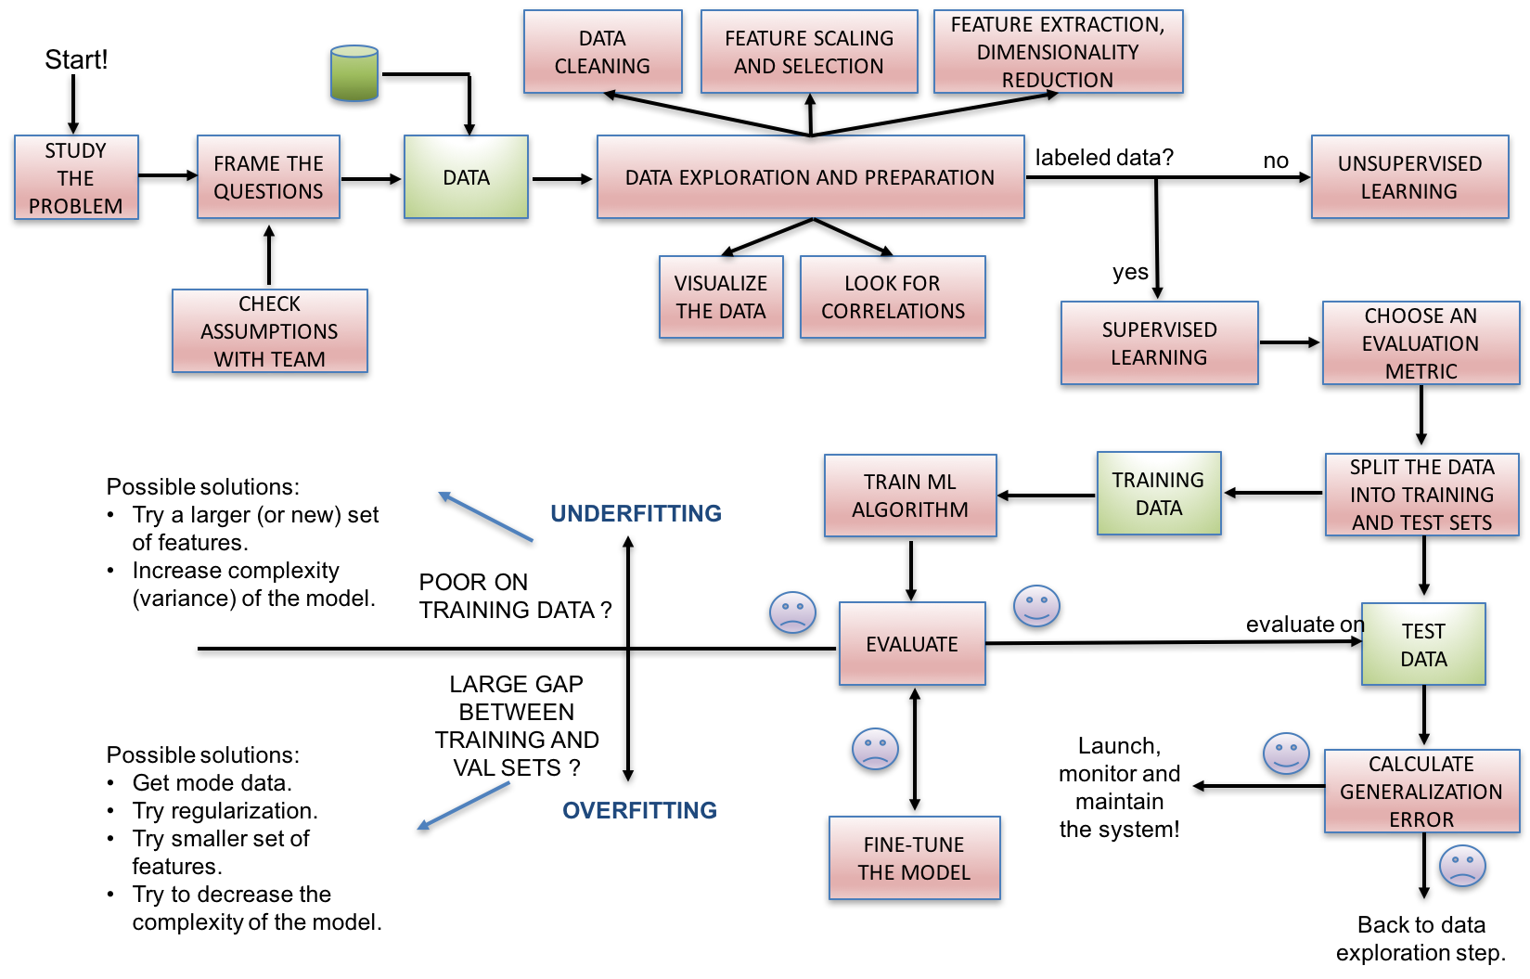
ML general workflow
Ayham and Leonardo (UWA)

Slide 26
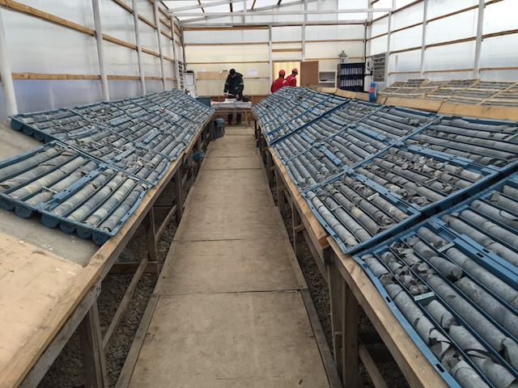
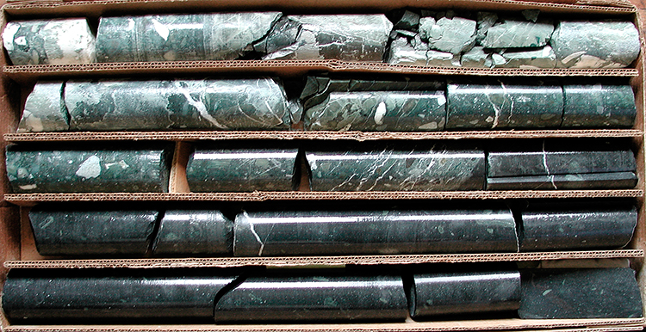
Day 8 Exercises
Scenario 1 (rock type problems):
Part 1: Your company has just taken over a new operating mine and you don't trust the old operator's classifications or rock models. You have a bunch of photographs of core and a pile of core trays. The asset manager has asked you to take a look at the photographs and determine roughly how many different types of rock you've got.
Questions: what sort of problem is this? What features could you extract from the data?
Part 2: You've taken a subset of exemplar rock types from your clusters and validated these with your geoscience function at head office who have given you some labels for each of the rock types. What approaches could you take to leverage this information to predict rock types across all the photographed core.
Part 3: You've been able to send some rocks off for assay - how would you predict the composition of the remaining rocks that you didn't assay.
Ayham and Leonardo (UWA)

Slide 27
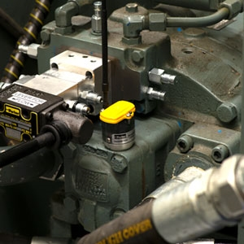
Day 8 Exercises
Scenario 2 (predictive maintenance problems):
You are working in the production section of an asset, and your boss has been lured into investing in a whizz-bang new vibration sensor for predictive maintenance. Your job is to work out whether you'll get any useful information out of the data.
Part 1: What sorts of features could you extract from a vibration sensor? How could you use these features for maintenance purposes? What kind of approaches or algorithms would you use?
Part 2: You have vibration data from failing machinery and machinery that is operating normally. What sort of problem is this? How would you approach it?
Part 3: Your maintenance manager wants to be able to plan the replacement and maintenance work based on likely time to failure. What data could you collect to measure this? What sort of prediction problem is it? Could you design an experiment to determine how accurate your predictions are?
Ayham and Leonardo (UWA)

Slide 28
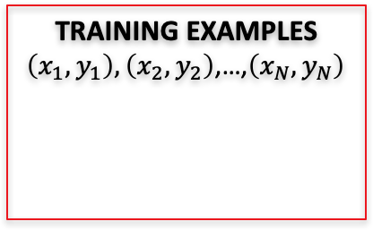
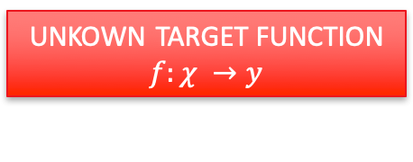
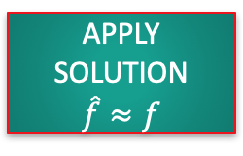
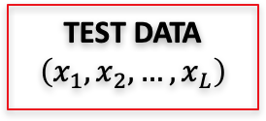
Day 8 Supervised Machine Learning: General Steps
UNKOWN TARGET FUNCTION
$$f:χ →y$$
(e.g. ideal formula to predict when to replace a component)
TEST DATA
$$\left(x_{1},x_{2},…,x_{L}\right)$$
STUDY THE
PROBLEM
TRAINING EXAMPLES $\left(x_{1},y_{1}\right),\left(x_{2},y_{2}\right)$,…,$\left(x_{N},y_{N}\right)$
LEARNING
ALGORITHM
EVALUATE
APPLY
SOLUTION
$$\hat{f}≈f$$
(e.g. learned maintenance prediction formula)
(e.g. historical records of maintenance)
ANALYZE
ERRORS
Picture adapted from: Hands on Machine Learning with Scikit-Learn and TensorFlow, Cap 1.
Ayham and Leonardo (UWA)

Slide 29

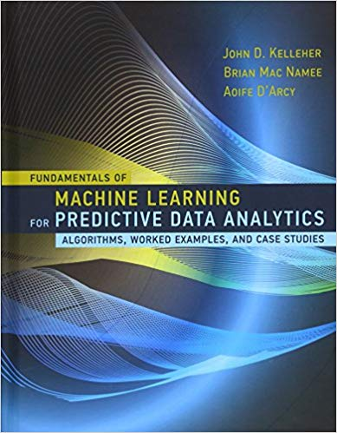

Day 8 Principal References
Scikit-learn: http://scikit-learn.org
Get prepared:
https://github.com/core-skills/08-machine-learning
Ayham and Leonardo (UWA)

Slide 30
Day 8 Supervised techniques: K-NN, Random Forest and SVM

Slide 31
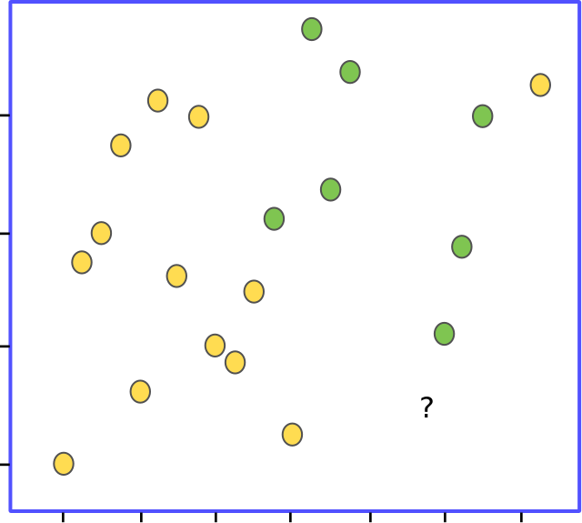
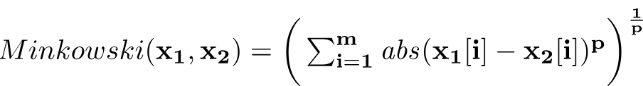
Day 8 K-Nearest Neighbors (K-NN)
Use for:
Classification and regression
Instance-based learning (model is not explicitly learned):
Idea: similar things are close to each other.
Based on measures of similarity: a distance metric defines the distance between the instances in a feature space.
Usually based on the Minkowski distance between two data instances x₁ and x₂ :
The parameter p defines the behaviour of the metric. If p = 1 we have the Manhattan distance, if p = 2 we have the Euclidean distance.
Source: Fundamentals of Machine Learning for Predictive Data Analytics, Cap. 5

Slide 32
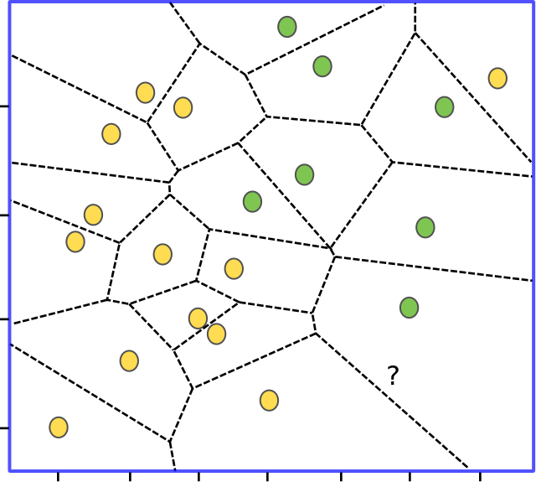
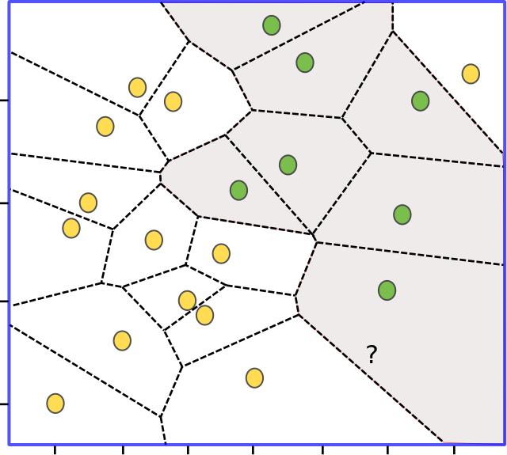
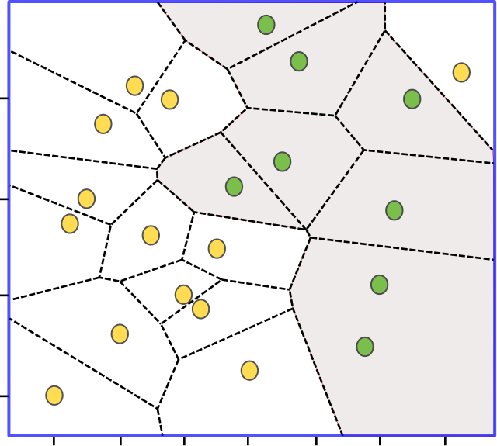
Day 8 K-Nearest Neighbors (Cont.)
However, sensitive to noise in the data.
Finding the nearest neighbor (K=1)
Decision boundary
updated.
Feature space is partitioned into a Voronoi tesselation: local partitions.
Implicitly, a global prediction boundary is determined by aggregating the local partitions within the feature space.
Ayham and Leonardo (UWA)
Source: Fundamentals of Machine Learning for Predictive Data Analytics, Cap. 5

Slide 33
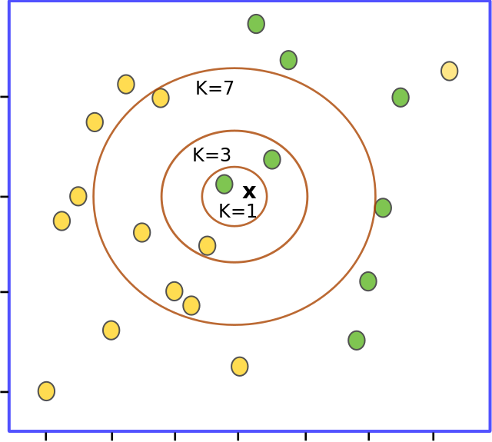
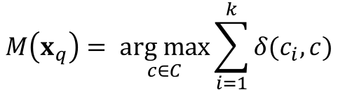
Day 8 K-Nearest Neighbors (Cont.)
Decrease the dependency on individual instances (K > 1).
Majority vote in the set of K nearest neighbors.
$$M\left(x_{q}\right)= \underset{c∈C}{arg max}{\sum_{i=1}^{k}{δ(c_{i},c)}}$$
Ayham and Leonardo (UWA)

Slide 34
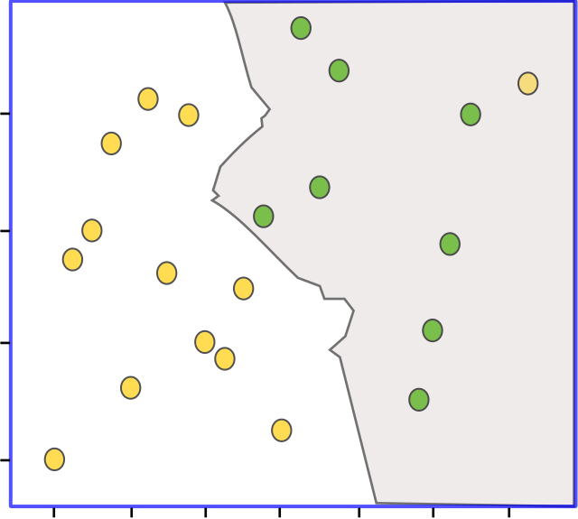
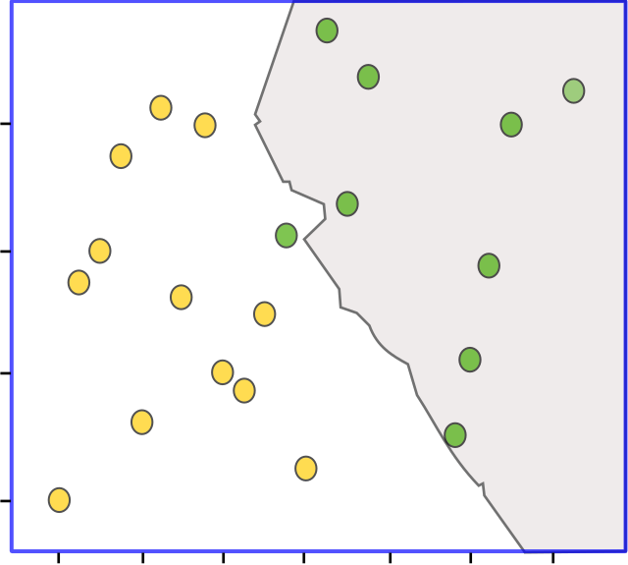
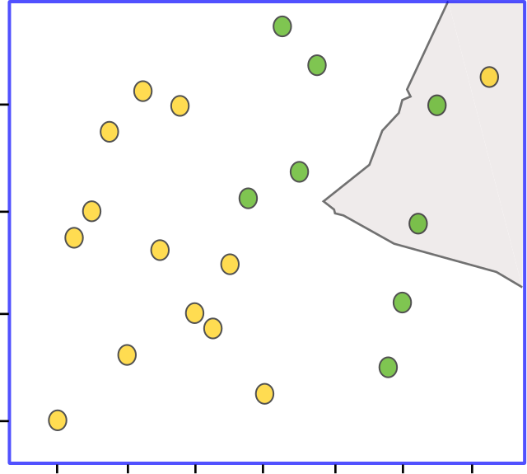
Day 8 K-Nearest Neighbors (Cont.)
Algorithm accounts neighbors that are too far.
K = 3
K = 5
K = 15
High values of K -> tendency towards the majority class, therefore do not work well for imbalanced datasets.
Ayham and Leonardo (UWA)
Source: Fundamentals of Machine Learning for Predictive Data Analytics, Cap. 5

Slide 35
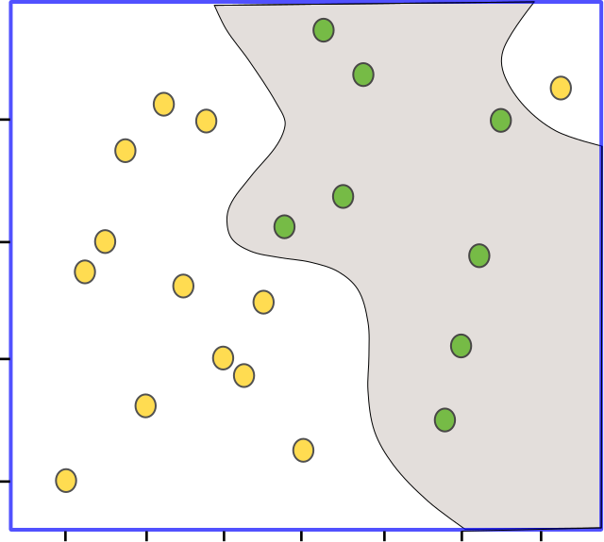
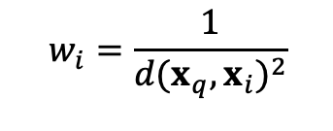
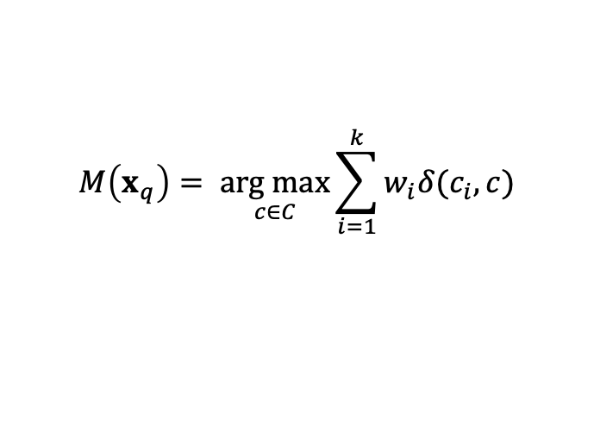
Day 8 K-Nearest Neighbors (Cont.)
Data cleaning is very important in a ML project!
Distance weighted K-NN
Weight the contribution of each neighbor w.r.t. the distance between the query and the neighbor:
Close neighbors -> higher weights (more relevance)
Distant neighbors -> less relevance.
K = 21
$$M\left(x_{q}\right)= \underset{c∈C}{arg max}{\sum_{i=1}^{k}{w_{i}δ(c_{i},c)}}$$
$$w_{i}=\frac{1}{{d(x_{q},x_{i})}^{2}}$$
Ayham and Leonardo (UWA)
Source: Fundamentals of Machine Learning for Predictive Data Analytics, Cap. 5

Slide 36
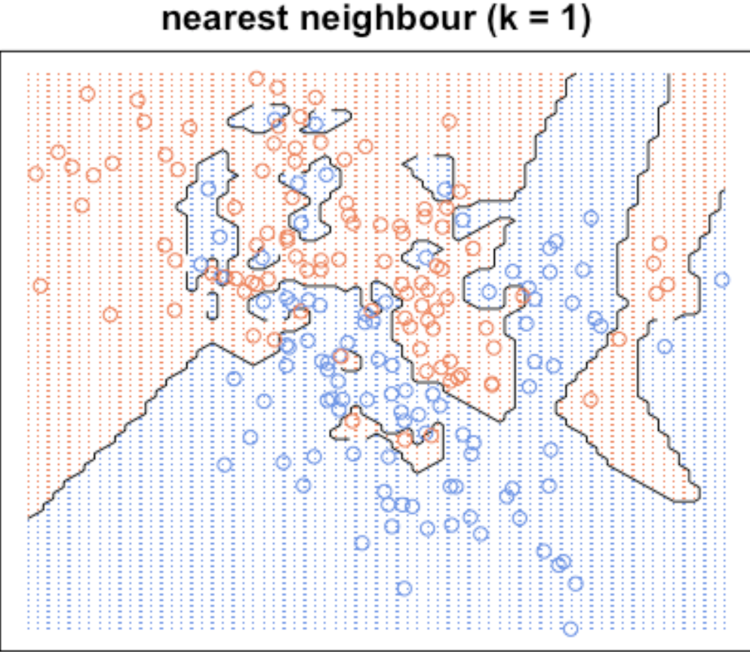
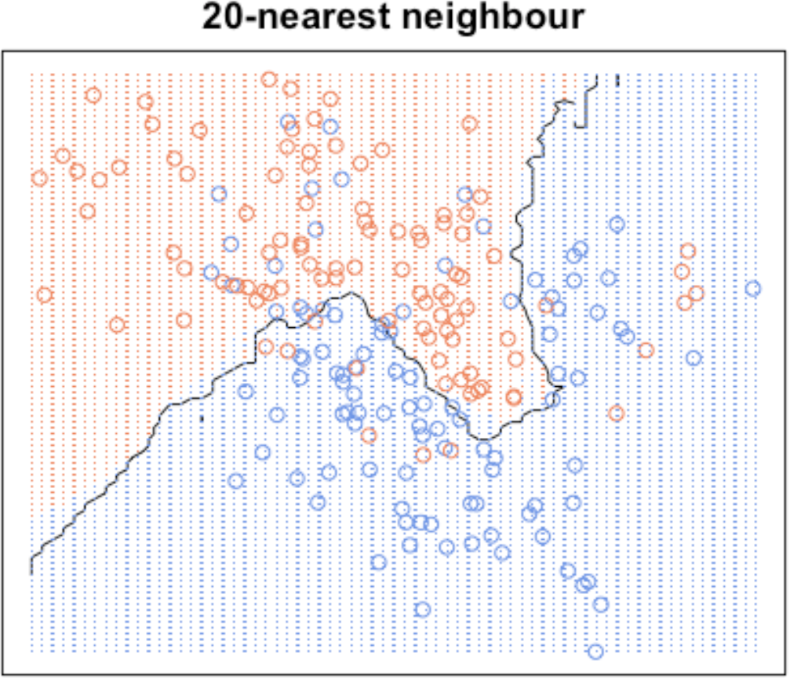
Day 8 Aspects of K-NN
Pros:
Simple and intuitive. Update the model is easy.
Can be used for semi-labelled data (samples together share same labels).
Easy to extend to multiclass classification.
Cons:
Memory-intensive.
Expensive testing or prediction.
Tradeoff: Small values of K -> risk of overfitting
Higher values of K >- risk of underfitting
Require a meaningful distance metric.
Sensitive to skewed datasets (even using variations).
Course of dimensionality -> usually dimensionality reduction techniques to help.
Ayham and Leonardo (UWA)
Source: https://kevinzakka.github.io/2016/07/13/k-nearest-neighbor/

Slide 37
Day 8 Aspects of K-NN (Cont.)
No assumptions about structure of the data.
Retrieval of similar items – but no learning/knowledge.
Works well when the density of the feature space in any point is fairly high.
Sufficient domain knowledge should be available – this helps to define a meaningful distance metric.
Noise and outliers may have negative effect.
Feature normalization is important -> the larger the scale the larger the influence of the feature.
Ayham and Leonardo (UWA)

Slide 38
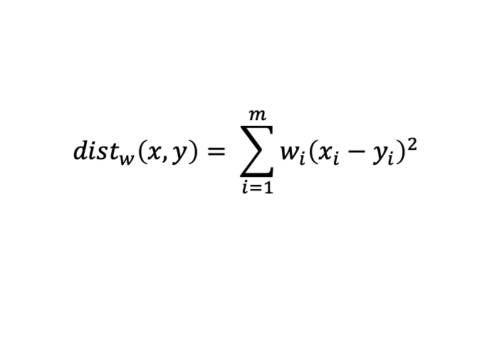
Day 8 Aspects of K-NN (Cont.)
What about feature importance?
Irrelevant features increase costs without affecting accuracy.
Misleading features increase costs and decrease accuracy.
Attribute-weighted K-NN
How to find the weights?
You have an expert to advice you.
Or, rely on ML!
$${dist}_{w}\left(x,y\right)= \sum_{i=1}^{m}{{w_{i}\left(x_{i}−y_{i}\right)}^{2}}$$
Optimized data structures and implementations:
Approximate Nearest Neighbor (k-d trees).
Locality sensitive hashing (LSH) – for higher dimensions.
Ayham and Leonardo (UWA)

Slide 39
Day 8 K-NN - Exercise
Exercise
Open am1-iron-ore-dataset.ipynb and go through the the exercises related to the KNN classification.
Ayham and Leonardo (UWA)

Slide 40

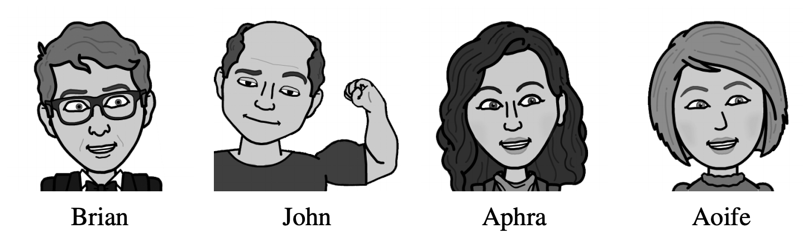
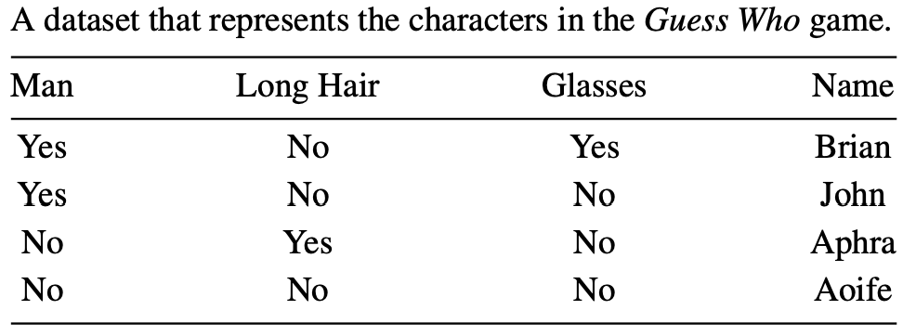
Day 8 Decision Trees
Someone picked Brian.
What should you ask first?
Is it a man?
Does the person wear glasses?
Ayham and Leonardo (UWA)
Sources: Fundamentals of Machine Learning for Predictive Data Analytics, Cap. 4; Hands on Machine Learning with Scikit-Learn and TensorFlow, Cap. 6

Slide 41
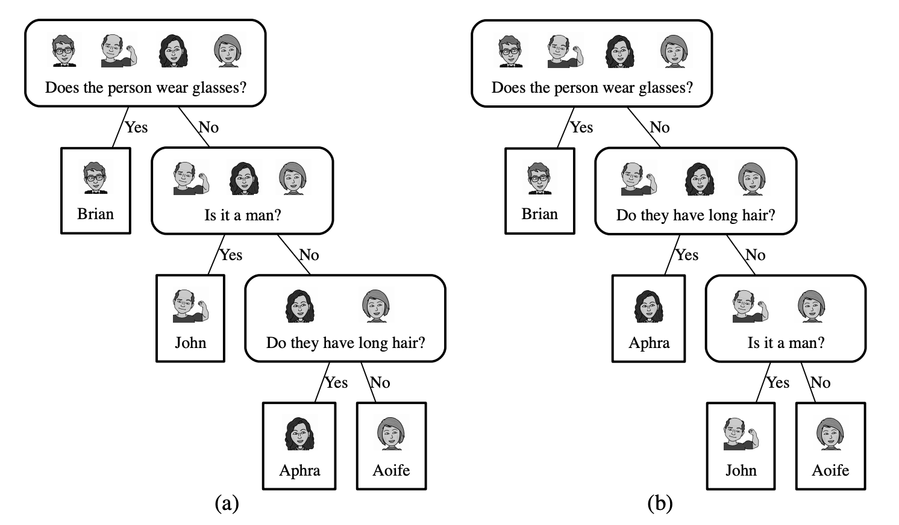
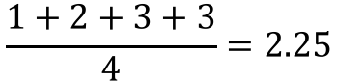
Day 8 Decision Trees (Cont.)
“Does the person wear glasses?”
$$\frac{1+2+3+3}{4}=2.25$$
That’s the average number of questions you have to ask per game.
Ayham and Leonardo (UWA)
Sources: Fundamentals of Machine Learning for Predictive Data Analytics, Cap. 4; Hands on Machine Learning with Scikit-Learn and TensorFlow, Cap. 6

Slide 42
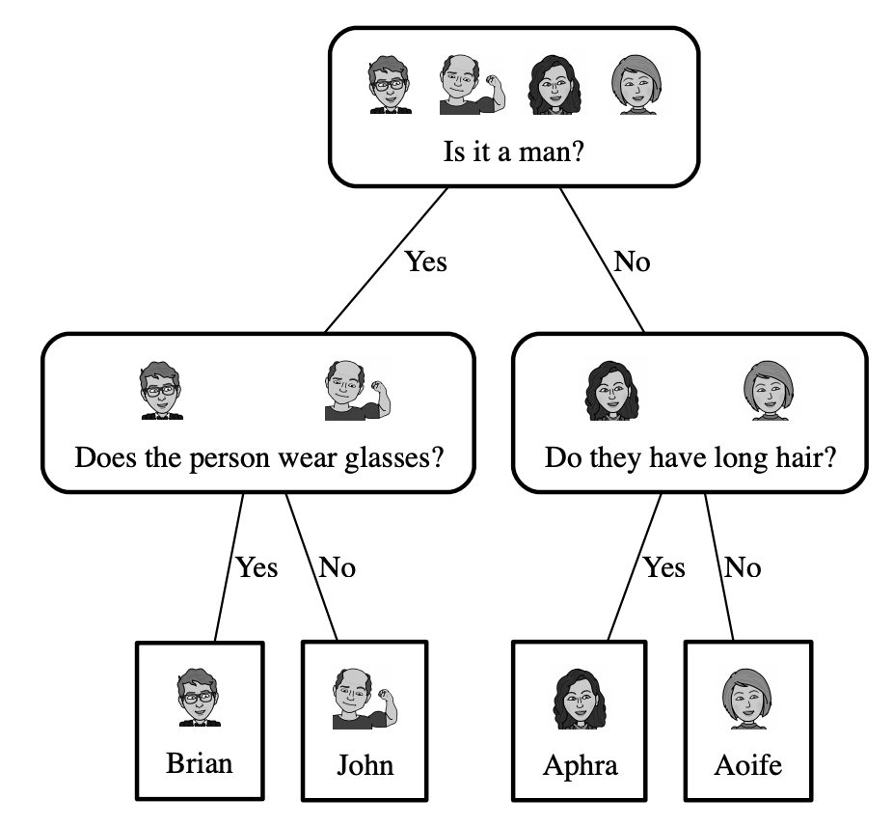
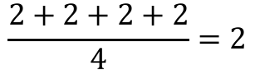
Day 8 Decision Trees (Cont.)
“Q1: Is it a man?”
$$\frac{2+2+2+2}{4}=2$$
That’s the average number of questions you have to ask per game.
“On average, an answer to Q1 is more
Informative that an answer to Q2.”
Ayham and Leonardo (UWA)
Sources: Fundamentals of Machine Learning for Predictive Data Analytics, Cap. 4; Hands on Machine Learning with Scikit-Learn and TensorFlow, Cap. 6

Slide 43
Day 8 Decision Trees (Cont.)
Used for:
Classification and regression.
Information-based learning:
Informativeness of a descriptive feature: split the dataset into branches that maximize the information gain, reducing the node’s impurity.
Find out which feature is more informative to ask questions about, consider the effects of different answers to these questions (how the domain will be split and the likelihood of each answer).
Ayham and Leonardo (UWA)
Sources: Fundamentals of Machine Learning for Predictive Data Analytics, Cap. 4; Hands on Machine Learning with Scikit-Learn and TensorFlow, Cap. 6

Slide 44
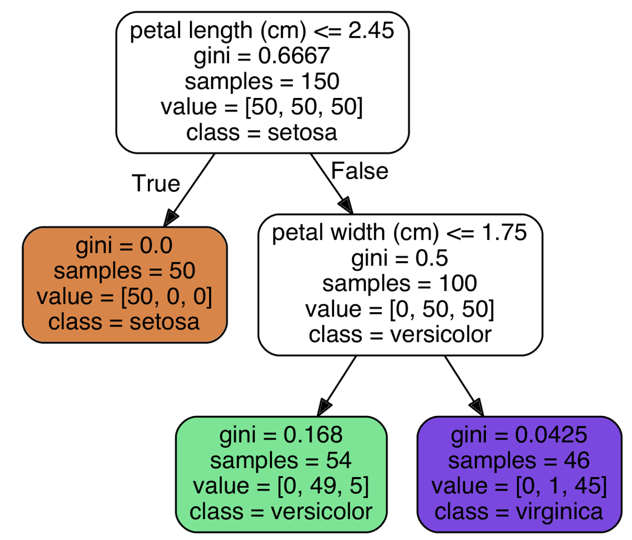
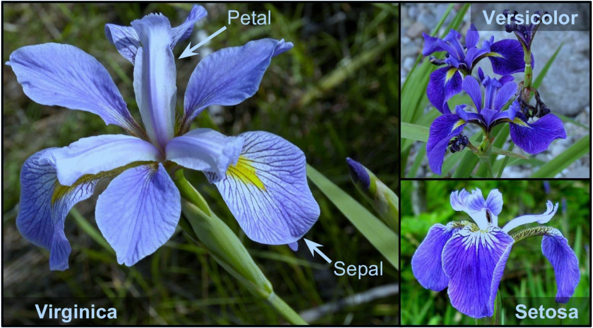
Day 8 Decision Trees (Cont.)
Ayham and Leonardo (UWA)
Sources: Fundamentals of Machine Learning for Predictive Data Analytics, Cap. 4; Hands on Machine Learning with Scikit-Learn and TensorFlow, Cap. 6

Slide 45
Day 8 Aspects of Decision Trees
Pros:
Works well for complex datasets.
Require very little data preparation (even scaling is not necessary).
Example of a white box approach: decisions are intuitive.
Make few assumptions about the structure of the data.
Ayham and Leonardo (UWA)

Slide 46
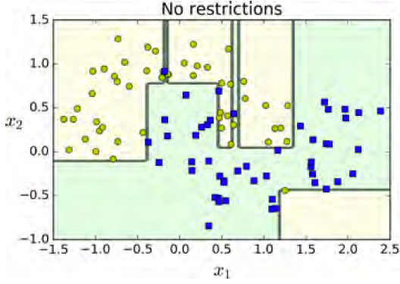
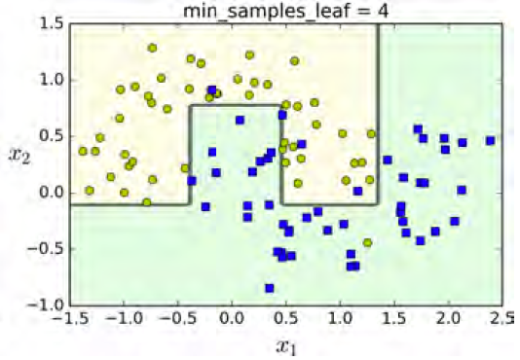
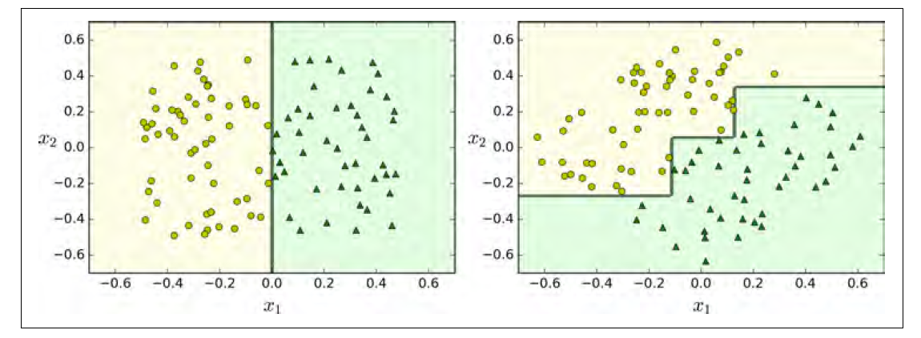
Day 8 Aspects of Decision Trees
Cons:
Rely on a good tuning of restrictions (hyperparameters) to avoid overfitting – otherwise trees can just memorize the training data. Pruning can also be used.
Sensitive to training set rotation. Option: use PCA for a better orientation of the training data.
Sensitive to small variations in the training set.

Slide 47
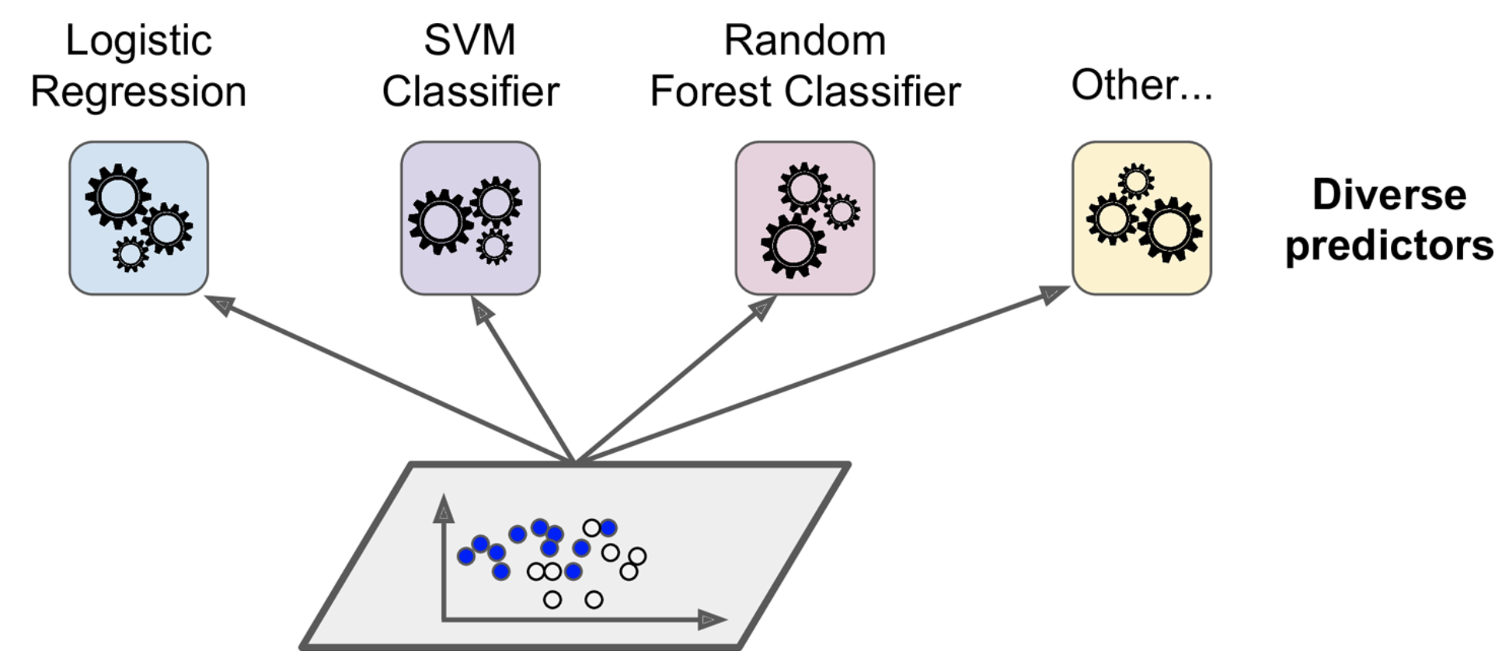
Day 8 Ensemble Learning
Idea:
Combine the predictions of many predictors to get a better final prediction.
1
1
2
1
1
Ayham and Leonardo (UWA)
Source: Hands on Machine Learning with Scikit-Learn and TensorFlow, Cap. 7.

Slide 48
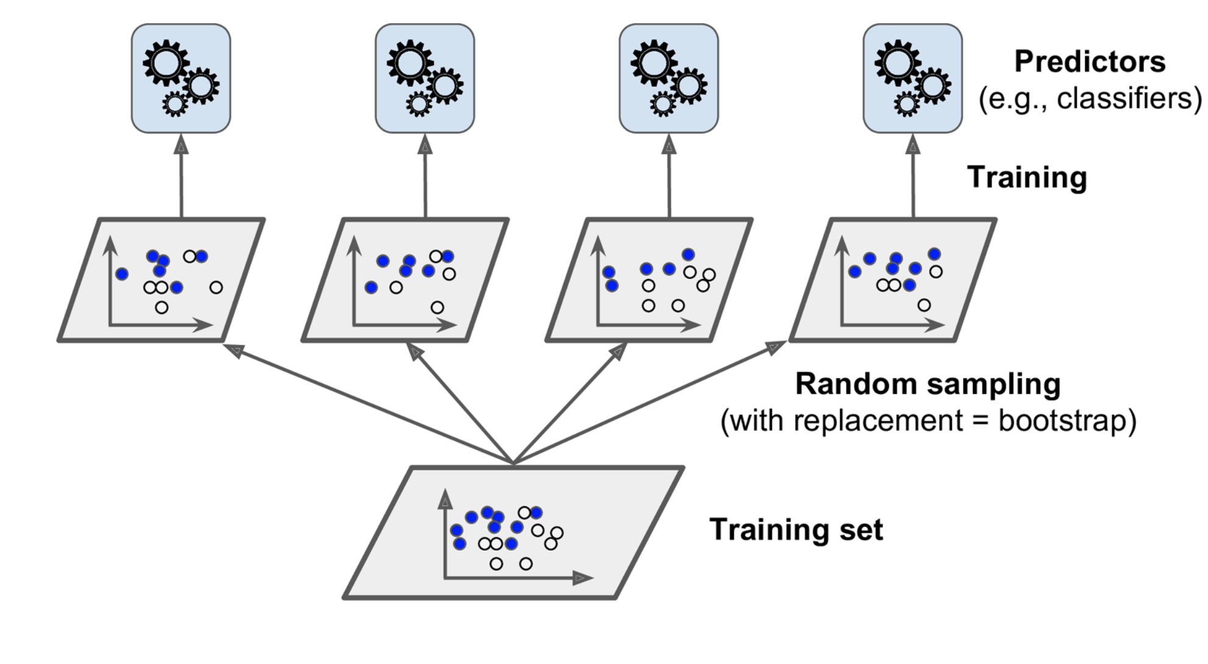
Day 8 Ensemble Learning (Cont.)
Bagging (Bootstrap aggregating) and pasting:
Train the models on different random subsets of the training set.
Individual predictors have high bias, but in overall aggregation produces lower bias and lower variance when compared to training one predictor.
Ayham and Leonardo (UWA)
Source: Hands on Machine Learning with Scikit-Learn and TensorFlow, Cap. 7.

Slide 49
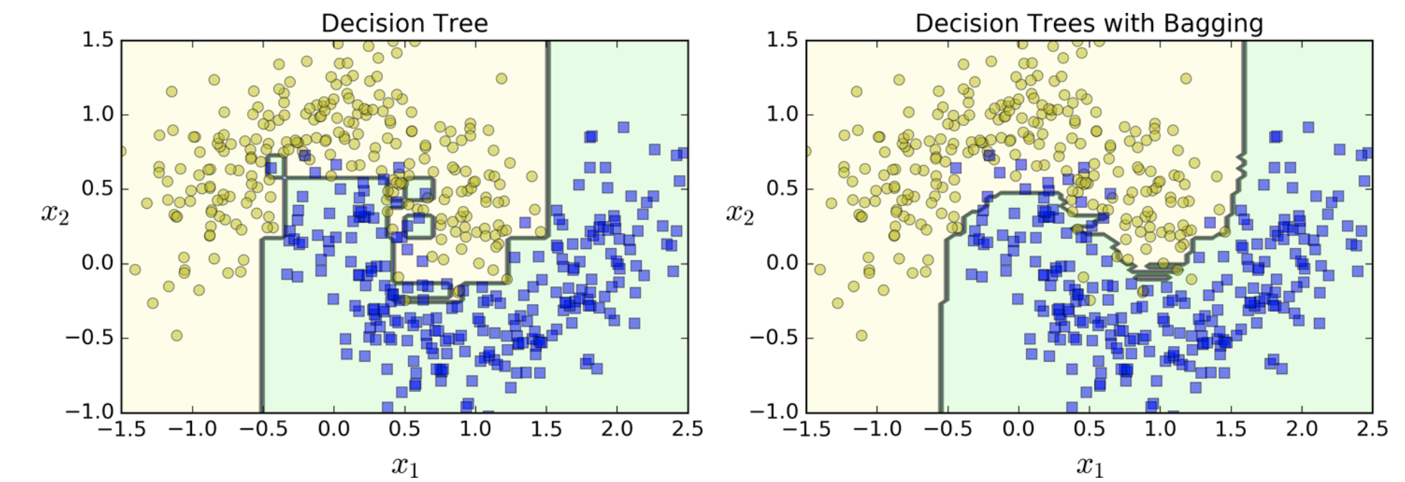
Day 8 Ensemble Learning (Cont.)
The ensemble’s prediction tends to generalize better than a single predictor.
Bagging or pasting?
Bagging introduces more diversity: slightly higher bias but lower variance.
Bagging tends to produce better results.
Other approaches:
Boosting (AdaBoost, Gradient Boosting), Stacking.
Ayham and Leonardo (UWA)
Source: Hands on Machine Learning with Scikit-Learn and TensorFlow, Cap. 7.

Slide 50
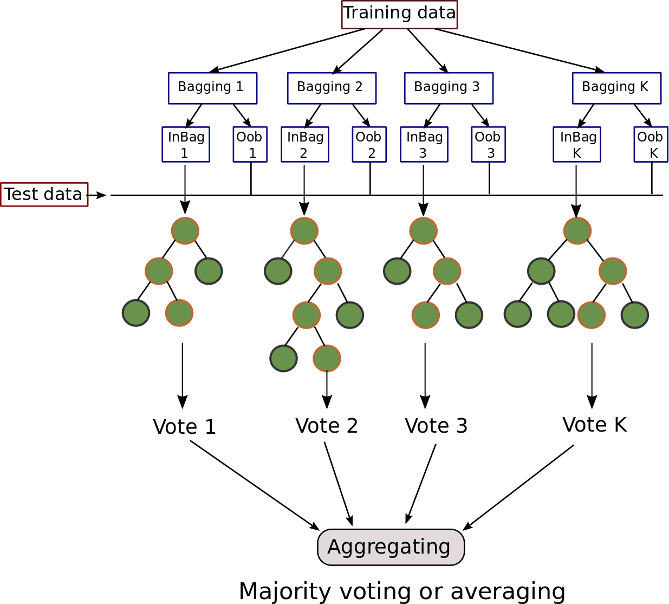
Day 8 Random Forests
An ensemble of Decision Trees:
Most commonly trained with the bagging method.
Searches for the most informative feature in a (random) subset of the training set.
Tree diversity flavours higher bias for a lower variance.
Feature Importance
Most important features are likely to be near the root.
Average depth at which a specific feature appears across all trees.
Feature_importance_variable.
Ayham and Leonardo (UWA)
Source: Hands on Machine Learning with Scikit-Learn and TensorFlow, Cap. 7.

Slide 51
Day 8 Aspects of Random Forests
Pros:
Among the most powerful ML algorithms.
Learn nonlinearities in the training set structure.
Robust to outliers.
Cons:
In each node, the training algorithm compares all features in all samples. It can be slow for larger datasets.
Attention to the regularization hyperparameters.
Ensemble makes prediction less intuitive.
Ayham and Leonardo (UWA)

Slide 52
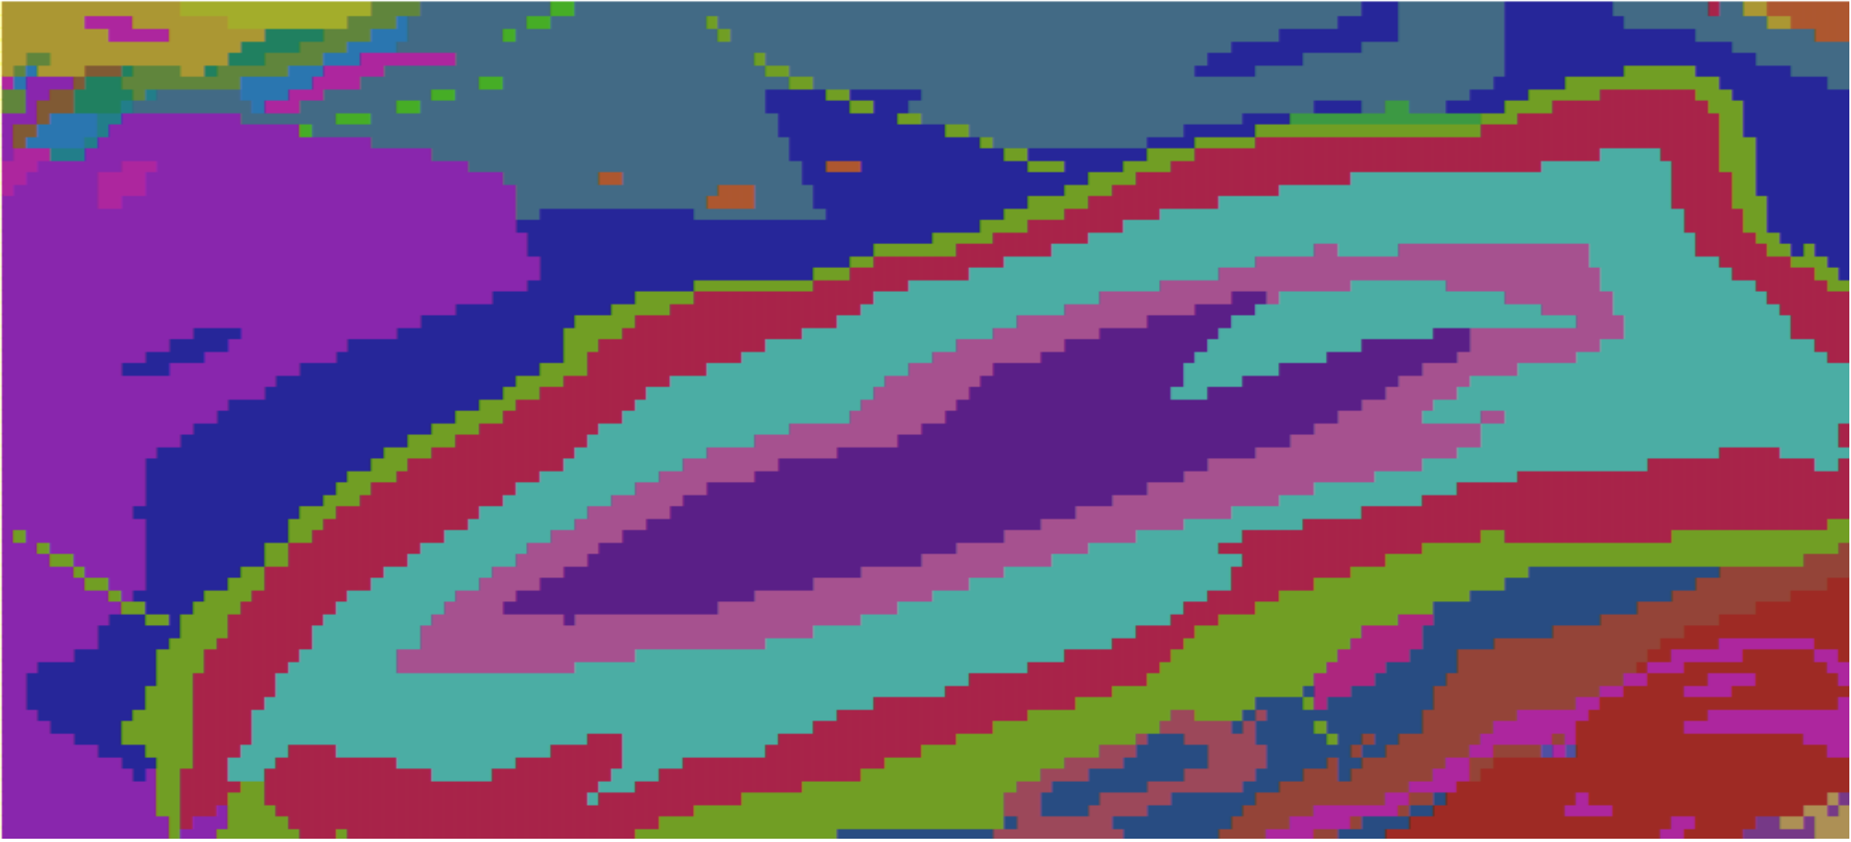
Day 8 Aspects of Random Forests (Cont.)
Promise technique when there are many discontinuities in the data structure (orthogonal features) – features showing almost no linear dependencies.
Identification of geological rocktypes
Source: Harvey, A. S., and G. Fotopoulos. "GEOLOGICAL MAPPING USING MACHINE LEARNING ALGORITHMS." International Archives of the Photogrammetry, Remote Sensing & Spatial Information Sciences 41 (2016).
Ayham and Leonardo (UWA)

Slide 53
Day 8 Random Forests - Exercise
Exercise
Open am1-iron-ore-dataset.ipynb and go through the the exercises related to the Random Forests classification.
Ayham and Leonardo (UWA)

Slide 54


Day 8 Support Vector Machines (SVMs)
Used for:
Classification and regression.
Large margin classification:
It maximizes the distance to the nearest points relative to both classes.
What that means?
More robust to classification errors, better generalization.
support
vectors
Ayham and Leonardo (UWA)

Slide 55



Day 8 Support Vector Machines (Cont.)
Hard margin classification:
Imposes all samples are correctly classified.
Sensitive to outliers.
Requires a linear separable solution.
What would be the correct SVM output?
First the correct classification, then maximize the margin.
Ayham and Leonardo (UWA)

Slide 56

Day 8 Support Vector Machines (Cont.)
Soft margin classification:
More flexible model.
Balance between maximizing the margin and allowing some misclassifications.
SVM are robust to outliers by mediating well this compromise.
How SVM control this balance?
Hyperparameter C can play a role if the model is overfitting: the larger the value of C the more intricate or restricted the decision boundary is.
Ayham and Leonardo (UWA)
Source: Hands on Machine Learning with Scikit-Learn and TensorFlow, Cap. 5.

Slide 57





Day 8 Support Vector Machines (Cont.)
Nonlinear classification?
$$x_{2}={(x_{1})}^{2}$$
Polynomial features
Kernel trick!
Polynomial features
Ayham and Leonardo (UWA)
Source: Hands on Machine Learning with Scikit-Learn and TensorFlow, Cap. 5.

Slide 58






Day 8 Support Vector Machines (Cont.)
Similarity features
Similarity function: Gaussian Radial Basis Function (RBF) with 𝛾 = 0.3
Hyperparameter 𝛄
Define how far the influence of a single training example reaches.
Low values led to smoother boundaries.
$$γ=\frac{1}{2σ^{2}}$$
Ayham and Leonardo (UWA)
Source: Hands on Machine Learning with Scikit-Learn and TensorFlow, Cap. 5.

Slide 59

Day 8 Support Vector Machines (Cont.)
Gaussian RBF Kernel
Ayham and Leonardo (UWA)
Source: Hands on Machine Learning with Scikit-Learn and TensorFlow, Cap. 5.

Slide 60


Day 8 Support Vector Machines (Cont.)
Regression
Reverse the objective - fit data samples within the margin.
Ayham and Leonardo (UWA)
Source: Hands on Machine Learning with Scikit-Learn and TensorFlow, Cap. 5.

Slide 61
Day 8 Aspects of SVMs
Pros:
Works well for complex small to medium-size datasets.
Works well in high-dimensional feature spaces.
Works reasonable well where number of dimensions is greater than number of data instances.
Estimation of the decision boundary is conducted on a subset of points – the support vectors.
Kernel trick allows the specification of complex decision functions.
Generally works well on sparse data.
Ayham and Leonardo (UWA)

Slide 62

Day 8 Aspects of SVMs (Cont.)
Cons:
Interpretability.
Sensitiveness to feature scales.
Slow for hundreds of thousands of instances.
Regularization is essential when the number of instances is much lower then the number of features.
Rely on the concept of distance – it has to be meaningful.
Trickier to tune. Rule of thumb: try first linear, then Gaussian RBF and then polynomial kernel.
Ayham and Leonardo (UWA)

Slide 63
Day 8 SVMs - Exercise
Exercise
Open am1-iron-ore-dataset.ipynb and go through the the exercises related to the SVMs classification.
Ayham and Leonardo (UWA)

Slide 64
Day 8 Evaluating the ML models

Slide 65
Day 8 The bias x variance Tradeoff
Underfitting
Overfitting
Ayham and Leonardo (UWA)

Slide 66
Motivation
Creating Machine Learning models is easy. However, creating good Machine Learning models is not that easy.
Press here
TRAIN
Ayham and Leonardo (UWA)

Slide 67
Motivation
Creating Machine Learning models is easy. However, creating good Machine Learning models is not that easy.
Press here
TRAIN
The only way to know how a model will generlise to new cases is to actually try it out on new cases, NOT practical.
Evaluating a model is a core part of building an effective machine learning model.
There are different evaluation metrics for different kind of problems.
The choice of the evaluation metric is completely depends on the type of the model and the problem.
Ayham and Leonardo (UWA)

Slide 68

Day 8 How to set up your data?
Training set: The subset of the data used to fit the model.
Development set: (also known as hold-out cross-validation set): The subset of the data that is not used in training, but it will be used to guide choices in the learning process, e.g., fine-tune of hyperparameters.
Test set: The subset of the data that is not involved in the training process - unbiased estimation of the generalization error.
Common choices used for many years: 80%-20%-20%, 70%-30%.
With the area of big-data: 90%-10%-10%, or even 98%-1%-1%.
Ayham and Leonardo (UWA)

Slide 69



Day 8 The learning curve
Plot the model performance and the number of training samples increases in time.
Which curves represents overfitting and which one represents underfitting?
Ayham and Leonardo (UWA)

Slide 70


Day 8 The learning curve
Underfitting
More training samples won't help.
Overfitting
More training samples might help
Ayham and Leonardo (UWA)

Slide 71

Day 8 K Fold cross-validation
Split the training set into K complementary subsets. Each model is trained and validated using a different combination of such subsets.
Stratified K-Fold Cross Validation for imbalanced datasets: each fold contains approximately the same proportion of each class.
Ayham and Leonardo (UWA)

Slide 72



Day 8 Performance Measures
Regression
$$y_{p}^{(i)}= h\left(x^{\left(i\right)}\right)$$
Root Mean Square Error (RMSE)
Mean Absolute Error (MAE): sometimes used when there are many outliers.
$$RMSE\left(X,h\right)= \sqrt{\frac{1}{m}\sum_{i=1}^{m}{{(y_{p}^{(i)}−y^{(i)})}^{2}}}$$
$$MAE\left(X,h\right)=\frac{1}{m}\sum_{i=1}^{m}{\left|y_{p}^{(i)}−y^{(i)}\right|}$$
Ayham and Leonardo (UWA)

Slide 73

Day 8 Performance Measures (Cont.)
Classification
Accuracy (trickier for imbalanced datasets)
Confusion matrix
Example
4344
1307
1077
53272
Accuracy over 95% !
Ayham and Leonardo (UWA)

Slide 74



Day 8 Performance Measures (Cont.)
Precision
Accuracy of positive predictions
Example:
$$precision= \frac{TP}{TP+FP}$$
Recall
1307
4344
Ratio of correct positive predictions
$$recall= \frac{TP}{TP+FN}$$
1077
53272
F1-score
Harmonic mean of prediction and recall
High F1 score if both precision and recall are high.
Precision = 77%
Recall = 79%
F1-score = 78%
$$F1= \frac{2}{\frac{1}{precision}+\frac{1}{recall}}=2 x\frac{precision x recall}{precision+recall}=\frac{TP}{TP+\frac{FN+FP}{2}}$$
Ayham and Leonardo (UWA)

Slide 75


Day 8 Performance Measures (Cont.)
Precision/Recall tradeoff
Increasing precision reduces the recall and vise versa.
Ways to select a good precision/recall tradeoff
Ayham and Leonardo (UWA)

Slide 76

Day 8 Performance Measures (Cont.)
1.0
The receiver operating characteristic (ROC) curve
Common tool used to compare classifiers.
It plots the true positive rate x false positive rate
Area under the curve (AUC)
true positive rate
classifier 1
classifier 2
0.0
false positive rate
0.0
1.0
AUC classifier 1 = 0.96
AUC classifier 2 = 0.99
AUC Random Classifier = 0.5
Ayham and Leonardo (UWA)

Slide 77
Day 8 More about ML: Regularization, toolboxes and further readings

Slide 78

Day 8 Directions for overfit/underfit
High bias: performance on the training set.
Try a larger (or new!) set of features.
Try high variance ML models (K-NN, SVM, RF, NN).
High variance: performance on the dev set.
Get more training data.
Try smaller set of features.
Try to decrease the complexity of the model.
K-fold cross validation.
Try regularization.
Ayham and Leonardo (UWA)

Slide 79




Day 8 Regularization
Penalize the parameters of the model (degrees of freedom) in order to produce a simpler model.
Tradeoff between increasing the bias and decreasing the variance.
Linear regression model prediction
MSE cost function for a Linear regression model
$$y_{p}=θ_{0}+ θ_{1}x_{1}+θ_{2}x_{2}+…+θ_{n}x_{n}$$
$y_{p}=h_{θ}\left(x\right)=θ^{T}.$ $x$
$$n is the number of features$$
$$θ_{j} is the j^{th} model parameter (feature weight)$$
$$MSE\left(X,h_{\left(θ\right)}\right)= \frac{1}{m}\sum_{i=1}^{m}{{(h(x^{\left(i\right)})−y^{(i)})}^{2}}$$
Ayham and Leonardo (UWA)
Source: Hands on Machine Learning with Scikit-Learn and TensorFlow, Cap. 3.

Slide 80



Day 8 Regularization (Cont.)
Penalize the parameters of the model (degrees of freedom) in order to produce a simpler model.
Tradeoff between increasing the bias and decreasing the variance.
Regularized linear models
Ridge Regression
(Tikhonov regularization)
$$J\left(θ\right)=MSE\left(θ\right)+λ\frac{1}{2}\sum_{i=1}^{n}{θ_{1}^{2}}$$
Fit the model keeping the model weights as small as possible.
Lasso Regression
(uses $l_{1}$ norm)
$$J\left(θ\right)=MSE\left(θ\right)+λ\sum_{i=1}^{n}{\left|θ_{i}\right|}$$
Tends to eliminate the weights of the less important features.
Sparse models.
Feature selection.
Ayham and Leonardo (UWA)

Slide 81







Day 8 Regularization (Cont.)
$$J\left(θ\right)=MSE\left(θ\right)+λ\frac{1}{2}\sum_{i=1}^{n}{θ_{1}^{2}}$$
$λ$ defines how much to regularize?
$λ=0$ –> no regularization
$λ$ too big
good $λ$
$λ$ too small
𝝀 too big: all weights tend to zero, result is a line through the data’s mean.
𝝀 too small: small penalties and therefore overfitting can still occur.
Ayham and Leonardo (UWA)

Slide 82
Day 8 Some toolboxes and open libraries
Scikit-learn: machine learning in python.
StatsModels: Python for statistical models.
Imbalanced-learn: ML for imbalanced datasets in python.
Shogun: machine learning library that supports many languages.
Spark MLlib: for scalable machine learning applications.
H2O: For fraud and tend predictions.
GoLearn: To build machine learning in Go language.
DeepLearn.js: Hardware accelerate machine intelligence for javaScript.
Ayham and Leonardo (UWA)

Slide 83

Day 8 Further reading
Medium website (nice tutorials for practical ML).
https://medium.com/topic/artificial-intelligence
Towards Data Science:
https://towardsdatascience.com
Oracle + Data Science:
https://www.datascience.com/blog
KDNuggets:
https://www.kdnuggets.com
Kaggle:
http://blog.kaggle.com
Stack Exchange:
https://stats.stackexchange.com
Ayham and Leonardo (UWA)

Slide 84
Day 8 Takeaways
Understanding the problem is the most crucial step.
Training set should be representative of new cases to be generalized.
And should contain relevant features.
Devote a time to explore the structure of the data.
Data matters more than algorithms for complex problems1.
Noise in your data can affect learning process, enhancing the probability of overfitting.
Simple models can give plausible results and should be tested first.
If the "test set" contributed to any aspect during the learning process, it is not a "test set", and assessment of future outcomes might be compromised.
If you data set is biased, your learning algorithm will produce a biased outcome as well (sampling bias problem).
Ayham and Leonardo (UWA)
1 - Halevy, A., Norvig, P., & Pereira, F. (2009). The unreasonable effectiveness of data. IEEE Intelligent Systems, 24(2), 8-12.

Slide 85
Day 8 Takeaways (Cont.)
What are your takeaways?
Next week:
Artificial Neural Networks
Deep Learning
Working with images
Homework:
Story and video class from HBR on Nokia’s company-wide ML approach
https://hbr.org/2018/10/the-chairman-of-nokia-on-ensuring-every-employee-has-a-basic-understanding-of-machine-learning-including-him
Ayham and Leonardo (UWA)
1 - Halevy, A., Norvig, P., & Pereira, F. (2009). The unreasonable effectiveness of data. IEEE Intelligent Systems, 24(2), 8-12.

